Slide 1

Algoritmos de Alta Performance
String × StringBuffer
Prof. Sérgio Ricardo Rota pf0112@fiap.com.br www.fiap.com.br

Slide 2
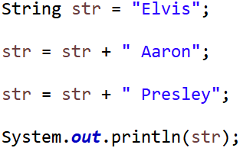
String pool
“Elvis”
“ Aaron”
“Elvis Aaron”
“ Presley”
“Elvis Aaron Presley”
String pool
2

Slide 3
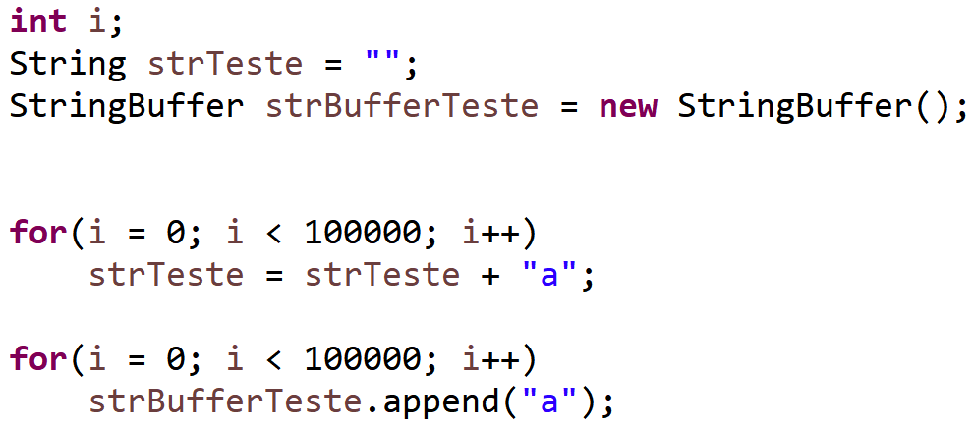
String × StringBuffer
3

Slide 4
String × StringBuffer
“a” “aa” “aaa”
“aaaa” “aaaaa” “aaaaaa”
“aaaaaaa” “aaaaaaa”
“aaaaa...aaa”
“aaaaa...aaa”
1 a 9.999 ‘a’
100.000 ‘a’
100.000 ‘a’
4

